Slide 1
Plagiarism
What it is and how to avoid it
Notes:
These lecture slides are based on Scribbr’s Knowledge Base article How to avoid plagiarism, which can be found here:
https://www.scribbr.com/plagiarism/how-to-avoid-plagiarism/
How to edit this presentation:
Click on ‘File’ in the top-left corner.
Click on ‘Make a copy’
Select ‘Entire presentation’
Save the presentation in your personal Google Drive.
You can now edit the copy of this presentation!

Slide 2
What is plagiarism?
Notes:
Audience question: Can anyone tell me what “plagiarism” means?
“What Is Plagiarism?” video: https://youtu.be/Uk1pq8sb-eo

Slide 3
Plagiarism defined
Dictionary definition of “plagiarism” (from Merriam-Webster):
To steal and pass off (the ideas or words of another) as one’s own: to use (another’s production) without crediting the source
Notes:
Plagiarism means stealing someone else’s work and passing it off as your own.
In academic writing, you plagiarize when you use someone’s exact words or paraphrase their ideas without crediting the original source.
Audience question: Is plagiarism always deliberate cheating?
“What is plagiarism?” article: https://www.scribbr.com/category/plagiarism/

Slide 4
Plagiarism explained
Can happen accidentally
Applies even if you paraphrase
Using other sources is good, as long as you cite them
Citing sources shows which ideas are your own
Notes:
Students sometimes plagiarize by accident, even if they don’t mean to cheat. To avoid accidental plagiarism, you need to understand how to properly use and cite sources.
Plagiarism doesn’t only mean copying and pasting other people’s work. It can also mean paraphrasing ideas or information without citing the source.
Using other researcher’s ideas is part of academic writing, but it’s important to do so correctly.
Citing your sources shows the reader which parts of the text are your own original ideas and which are the work of others. It also allows your reader to check the source for themselves.

Slide 5
Consequences of plagiarism
Grade penalties
Failing your course
Disciplinary action
Suspension or expulsion
Notes:
Plagiarism isn’t only an issue for students—there have been many high-profile plagiarism scandals outside of universities. An accusation of plagiarism can have serious legal or political consequences.
For example, Joe Biden dropped out of the 1988 presidential race after he was accused of plagiarizing his speeches from various other politicians. More recently, Melania Trump has been accused of plagiarizing speeches and publications.
In the academic world, the consequences of plagiarism depend on how badly you plagiarized and whether it’s believed to be accidental or deliberate.
You could be given a lower grade, fail your course, or face disciplinary action from the university.
In severe or repeated cases, you might be suspended or expelled.
So it’s very important to avoid plagiarism!
“Consequences of plagiarism” article: https://www.scribbr.com/plagiarism/consequences-of-plagiarism/

Slide 6
How to avoid plagiarism
3 steps to follow
Notes:
To avoid plagiarism, follow these 3 steps while preparing and writing your academic assignments.
“How to Avoid Plagiarism with 3 Simple Tricks” video: https://youtu.be/uQhVDH9p7aU

Slide 7
Step 1: Keep track of your sources
Keep a list of all the sources you consult
Sources include websites, videos, magazines, etc.
Note down sources just in case, even if you’re not sure you’ll use them
Notes:
The first step is to keep track of your sources as you do your research.
Note down details of every source you look at, even if you’re not sure whether you’ll use it in your paper.
Not only books and journal articles are sources; you should also keep track of any websites and multimedia sources you consult while doing your research. That includes things like YouTube videos, podcasts, images, and even social media posts.
Audience question: What kind of information about your sources might be important to write down?

Slide 8
Details to write down
Author name
Source title
Publication date
Publisher
Page numbers of specific quotes or passages
URL or DOI for online sources
Access date for online sources
Notes:
Important details to note down include the name of the author, the title of the source, the publication date, and the publisher.
If you find specific quotes or pieces of information you might want to use, write down the page numbers.
For online sources, keep a note of the URL of the source, or the DOI if there is one available (e.g. for a journal article).
It’s also important to write down when you accessed an online source, in case it changes over time.

Slide 9
Step 2: Quote or paraphrase
Two ways of sharing information from a source:
Quoting | Paraphrasing
Copy the author’s exact words Use quotation marks | Put the text into your own words No quotation marks
Notes:
The second step is to incorporate information from your sources into your text as you write.
Quoting and paraphrasing are two ways you can use a source without plagiarizing.
You can use quotes and paraphrases to share information and ideas from your sources, to provide evidence for your arguments, and to comment on the work of other researchers.

Slide 10

Notes:
This video walks you through the process of quoting.

Slide 11
Example of quoting
According to Darwin, “as natural selection acts solely by accumulating slight, successive, favourable variations, it can produce no great or sudden modification; it can act only by very short and slow steps” (1859, p. 510).
Notes:
To quote, copy the exact words from the original source.
Use quotation marks to show that these are not your own words.
Introduce the quote and integrate it into your own sentence—quotes shouldn’t stand alone as full sentences by themselves.
Audience question: When might it be better to quote a source directly rather than paraphrasing?
“How to quote sources” article: https://www.scribbr.com/citing-sources/how-to-quote/

Slide 12
When to use quotes
To give textual evidence
To analyze language
To give precise definitions
Notes:
If you are using primary sources (e.g. historical documents or literary texts), quote to give textual evidence for your claims.
If you are interested in the language the author uses (e.g. in literary analysis or discourse analysis), quote passages in order to analyze them.
Quotes can also be used to give precise definitions without changing the author’s meaning.
But don’t overuse quotes! The majority of your writing should be in your own words.
Always consider whether a quote is really necessary, or if it would be better to paraphrase.

Slide 13

Notes:
This video gives a quick guide to effective paraphrasing.

Slide 14
Example of paraphrasing
According to Darwin, natural selection is a gradual process that produces many small changes over time rather than sudden leaps (1859, p. 510).
Notes:
To paraphrase, put the original text into your own words.
Don’t just change a few words—it’s important that the text be completely rephrased.
If a paraphrase is too close to the original text, you are at risk of plagiarism.
“How to paraphrase” article: https://www.scribbr.com/citing-sources/how-to-paraphrase/

Slide 15
When to paraphrase
To share information
To explain ideas
To show your understanding of the source
Notes:
Paraphrasing allows you to share relevant information from your sources.
You can also use it to explain an author’s ideas, theories or arguments.
Paraphrasing is usually the best choice to demonstrate that you have fully understood the source.

Slide 16
Step 3: Cite the original source
In-text citations briefly identify the source
A reference list gives full source information
Follow a consistent citation style (e.g. APA, MLA, Chicago)
Online citation generators can help
Notes:
The third step is to add an in-text citation after each quote or paraphrase.
Each citation must correspond to an entry in the reference list at the end of your text, where you give full details about the source.
There are many different citation styles: Some popular ones are APA, MLA, and Chicago styles.
Different citation styles present information differently; for example, some use footnotes while others use parentheses for in-text citations.
Make sure you are following the style required by your department, or choose one and follow it consistently.
There are various citation generators available online to help you automatically create citations in the correct format.
Scribbr’s APA and MLA Citation Generators are free, accurate, and allow you to save your sources as you go. When you’re done, you can easily copy your in-text citations and export your reference list.
Free APA Citation Generator: https://www.scribbr.com/apa-citation-generator/
Free MLA Citation Generator: https://www.scribbr.com/mla-citation-generator/
“Citation styles” article: https://www.scribbr.com/citing-sources/citation-styles/

Slide 17
APA citation example
In-text citation:
Recent research has shown that plagiarism is an increasingly widespread issue (Smith & Thomas, 2018, pp. 34–36).
Reference list entry:
Smith, T. H., & Thomas, L. (2018). New challenges in higher
education. Free Press.
Notes:
APA is the most commonly used citation style.
These examples show an APA in-text citation and reference list entry for a book.
The in-text citation contains the authors’ last names, the publication year, and the page range of the paraphrased passage.
The reference list gives the authors’ names and initials, the publication year, the title, the place of publication, and the publisher.
APA citation guidelines article: https://www.scribbr.com/category/apa-style/

Slide 18
How is plagiarism detected?
Notes:
Audience question: So how does your teacher find out if you’ve plagiarized (either deliberately or accidentally)?
Universities have specific procedures for ensuring that students don’t plagiarize.
Your teacher might simply notice that a passage doesn’t match your writing style, or recognize an idea from a source they’re familiar with.
However, most universities also use plagiarism checkers to automatically detect similarities.

Slide 19
Plagiarism checkers
Used by universities to detect plagiarism
Compares your document to a database of sources
Detects text that is too similar to other sources
Detects where citations are missing
Notes:
Plagiarism checker technology compares your document to a huge database of sources, which includes books, journals, and websites, as well as student papers and theses that have previously been submitted.
The technology detects similarities between texts.
It can recognize similarities in a sentence or paragraph even if the words aren’t 100% identical—so just swapping a few words or changing the order of phrases isn’t enough to fool it!
The plagiarism checker produces a report with a similarity percentage and a list of similarities found.
This shows places where citations are missing or where text has not been properly quoted or paraphrased.
Not every similarity is really plagiarism, but the report allows your teacher to check each similarity, especially if the percentage is high. If it looks like plagiarism has been committed, they will investigate further.

Slide 20
Using a plagiarism checker yourself
Check if you can download a plagiarism report when you submit your assignment
If not, plagiarism checker services are available online
Not all online plagiarism checkers are safe – make sure to use a reliable one
Notes:
Check if you can get a plagiarism report when you submit your assignment. You’ll often be able to do this and then re-submit it once you’ve addressed any problems and added your citations.
If your university doesn’t offer this option, there are third-party plagiarism checker services available that you can use yourself before handing in your assignment.
Plagiarism checkers are useful for avoiding accidental plagiarism. You can use them to make sure that you’ve properly quoted, paraphrased, and cited.
Free online plagiarism checkers aren’t always safe or accurate, so do your research first. Some free plagiarism checkers store your paper in a database or even sell it on.
Plagiarism checker comparison: https://www.scribbr.com/plagiarism/best-plagiarism-checker/
Free plagiarism checker comparison: https://www.scribbr.com/plagiarism/free-plagiarism-checker-comparison/
Scribbr Plagiarism Checker: https://www.scribbr.com/plagiarism-checker/

Slide 21
True or false?
You still need to cite your source even when you paraphrase.
Plagiarism is always deliberate.
Online sources do not need to be cited.
Notes:
Let’s do a short quiz to conclude.
I want to know whether each of these statements is true or false:
1. You still need to cite your source even when you paraphrase.
2. Plagiarism is always deliberate.
3. Online sources do not need to be cited.

Slide 22
True or false?
You still need to cite your source even when you paraphrase.
TRUE: Whether quoting or paraphrasing, you need a citation.
Plagiarism is always deliberate.
FALSE: Many students plagiarize by accident.
Online sources do not need to be cited.
FALSE: If you use online sources, you need to cite them too.
Notes:
Number 1 is true: You need to cite your sources whether you quote or paraphrase, because in both cases you’re using the ideas of others.
Number 2 is false: Many students don’t mean to plagiarize but get in trouble because they fail to quote, paraphrase, or cite correctly. This is why it’s so important to understand how to incorporate your sources properly.
Number 3 is also false: If you use web sources in your writing, it’s just as important to cite them properly as it is for print sources.

Slide 23
Recommended resources

Slide 24
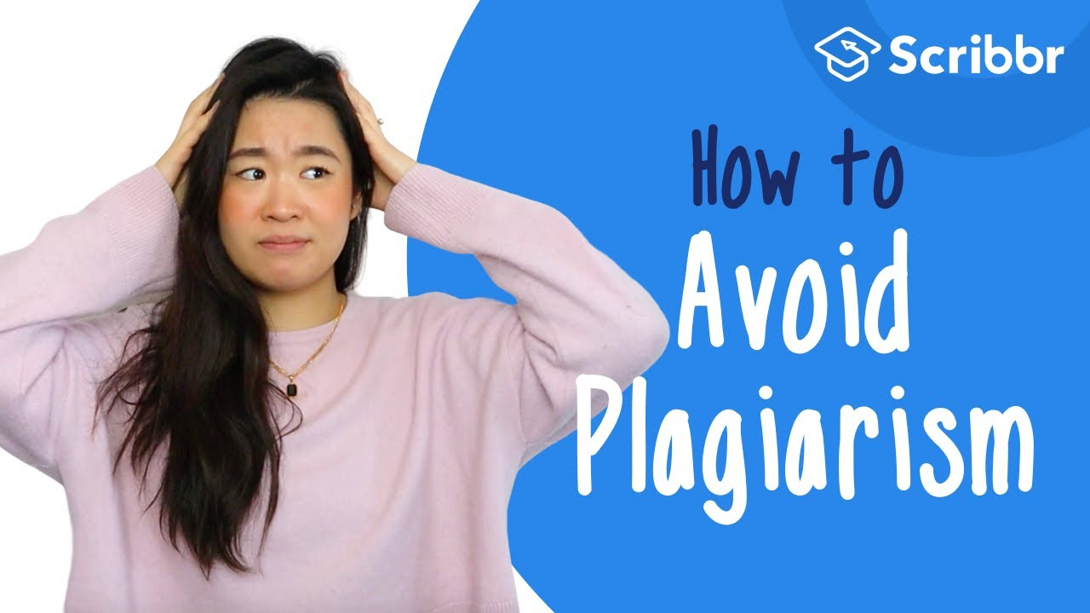
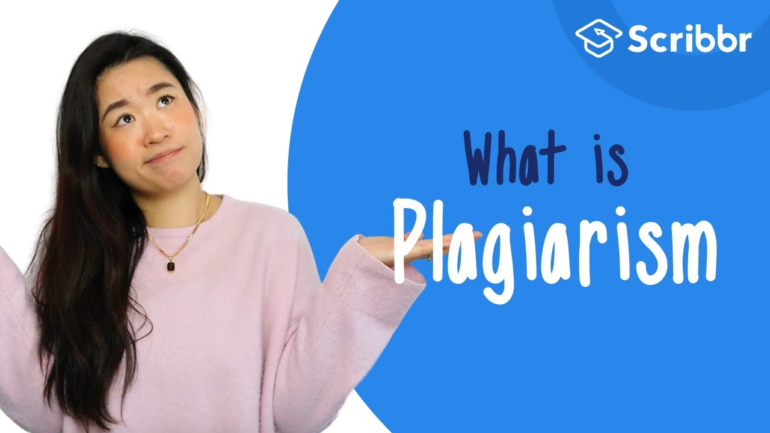
Free Scribbr resources
Knowledge Base (300+ articles)
YouTube Channel
APA Citation Generator
MLA Citation Generator
Notes:
Scribbr provides high-quality articles and videos for free. Every month over 2 million students make use of these resources.

Slide 25
Hi, we’re Scribbr 👋
We are a team of 60 people in Amsterdam, and we partner with more than 500 freelance editors across the globe to help students graduate and become better academic writers.
Every day, we work hard on our Proofreading & Editing service, Plagiarism Checker, Citation Generator, Knowledge Base and educational YouTube channel.

Slide 26
Guidelines for using this presentation
This presentation can be freely used and modified for educational purposes. You may:
Display this presentation in a classroom environment
Modify or delete slides
Distribute this presentation in print or in private student environments (e.g. Moodle, BlackBoard, Google Classroom)
Please do give credit to Scribbr for creating this resource.
Questions or feedback? Email shona@scribbr.com and we’ll be in touch!
Notes:
How to edit this presentation:
Click on ‘File’ in the top-left corner.
Click on ‘Make a copy’
Select ‘Entire presentation’
Save the presentation in your personal Google Drive.
You can now edit the copy of this presentation!

